Slide 1
Hazing Prevention
Fall 2025 Strategic Initiatives
Dr. Ann Coombes Goodman, Dean of Students
Dr. Vanetta Busch, Director of Hazing Prevention
& Organizational Development
Division of Student Life
Notes:
Good evening,
The Center for Learning and Professional Development

Slide 2

Agenda
Hazing Prevention updates
Solicit feedback/guidance on how faculty can get more involved.

Slide 3
Stop Hazing Assessment (1/2025)
Campus culture
Small, tight-knit campus community
The city of Las Cruces
Supporting first-generation students
Leadership and resources
Campus traditions
Campus hazing climate
Define and conceptualize hazing?
Where hazing happens?
What are types of hazing?
Why hazing happens?
Report hazing?
Hazing prevention?

Slide 4
Stop Hazing Recommendations
Hazing is a complex problem woven into the culture and reflected in the climate of any campus. Prevention requires a multi-dimensional approach.
Effective prevention must involve a range of stakeholders within the institutional community and would be more effective if they encompass data driven and research based strategies directed to mitigate contributing factors and enhance protective factors.
Establishing a task force/campus coalition (HPC) that engaging in a careful program analysis with hazing as a focus.
Because of Federal Campus StopHazing legislation, hazing is now a Clery reportable offense.
Notes:
Campus culture
Small, tight-knit campus community
The city of las cruces
Supporting first-generation students
Leadership and resources
Campus traditions

Slide 5
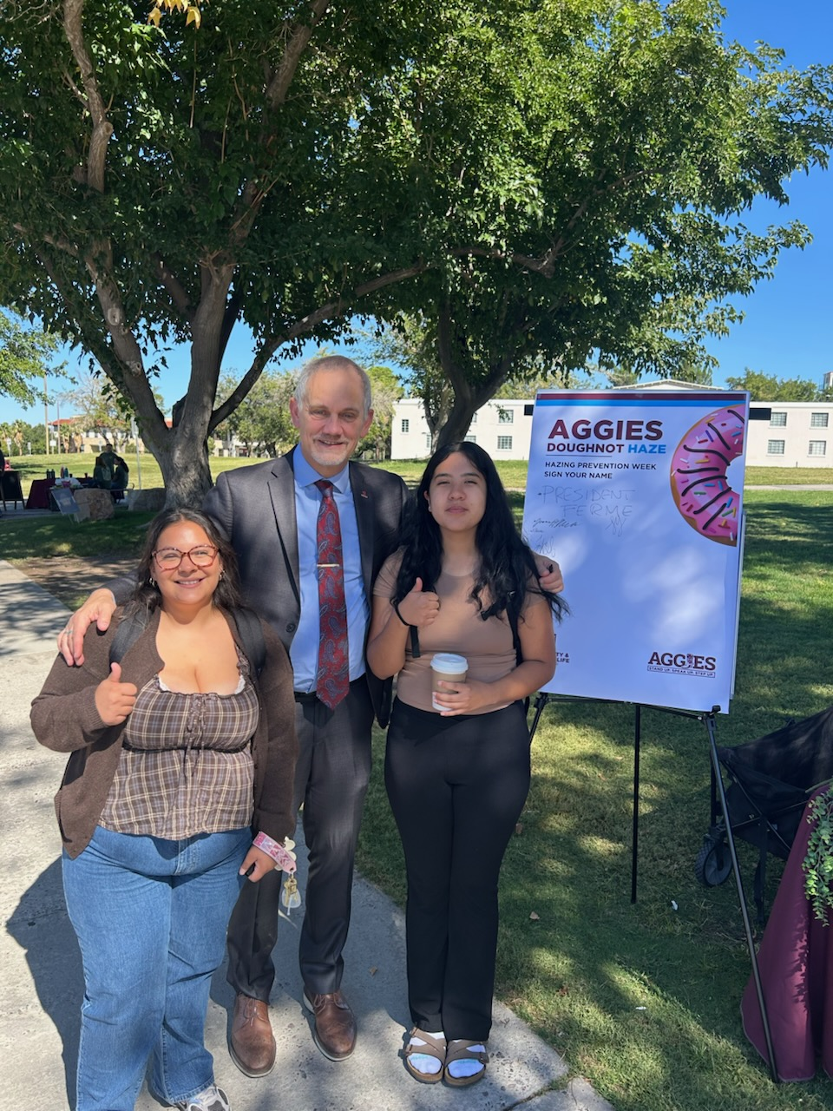
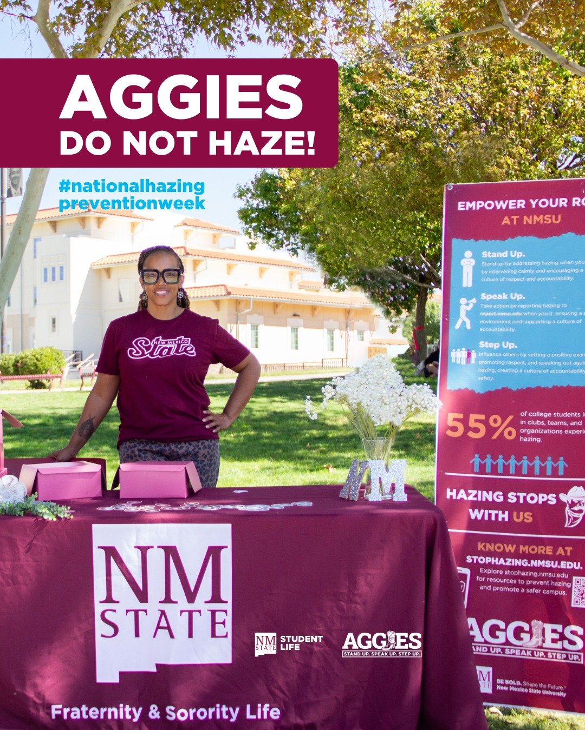
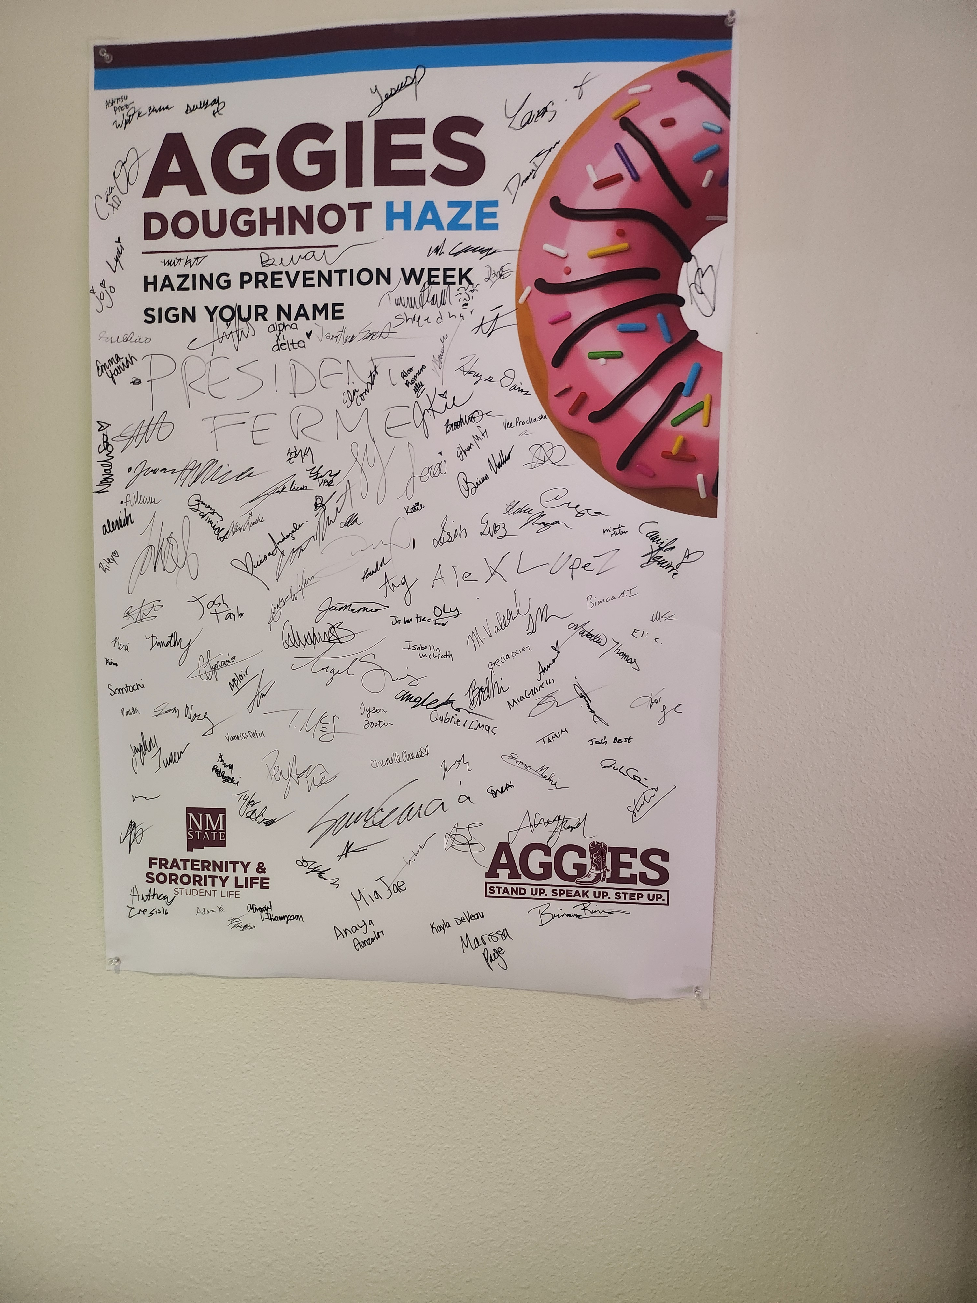
Introduction to Hazing

Slide 6
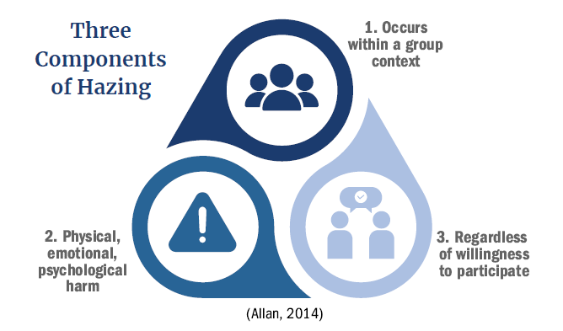
What is hazing?
“Any activity expected of someone seeking or maintaining membership in a group that humiliates, degrades, abuses, or endangers them regardless of a person’s willingness to participate” (Allan & Madden, 2008; Hoover, 1999)
SSCC Conduct Standards
NMSU Policies include: ARP Chapter 3 outlines NMSU Ethics, Equity, and Equal Opportunity policy. More importantly, subsection 3.80 specifically addresses NMSU’s position on the prohibition of bullying, hazing, and hostile misconduct (non-discriminatory)

Slide 7

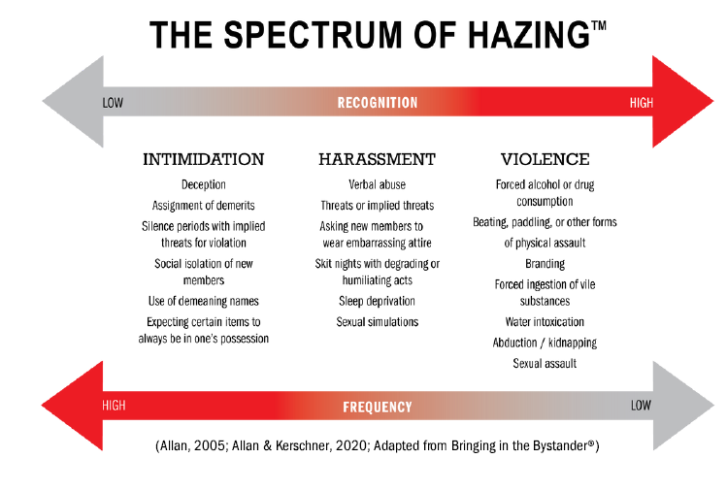
What is the spectrum of hazing?

Slide 8
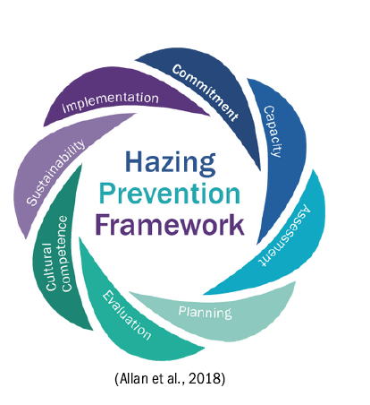
How do you prevent hazing?
There are eight interconnected components in this framework: Commitment,
Capacity
Assessment
Planning
Evaluation
Cultural Competence
Sustainability and
Implementation

Slide 9

Everyone has a role to play in preventing hazing
Fall 2025
23,000 students
226 Clubs and Organizations (advisors)
8,000+ professionals (including faculty, staff, and administrators)

Slide 10
Stakeholders and HPC task force
GREAT RESOURCE please see our website: https://stophazing.nmsu.edu/
Athletics
All student athletes have participated and/or will participate in hazing prevention training.
During NHAW (National Hazing Awareness Week), the men’s basketball team and coaches provided students with rides and hazing questions.
Housing and Residence Life
Residence Assistant and Leaders were trained in Hazing Prevention at the beginning of the semester.
Fraternities/Sororities
All prospective members must attend Greek 101 that addresses hazing, alcohol, substance abuse, and sexual assault.
Sponsored a tabling event soliciting Aggies to sign the Aggies Doughnut Haze while receiving doughnuts during NHAW.
Aggie Health and Wellness
Sponsored rides for students during NHAW.
Student Involvement Leadership Program (SILP)
Provided tabling support during NHAW.
President Office
Opened up NHAW with his signature and pledge.
College of Business
Dean of Students provided MGMT 333 students with Hazing Prevention Training during class.
ASNMSU
President and officers shared their knowledge on hazing
KRUX 91.5 FM
Provides hazing prevention spotlight narrative monthly.
Social Media activities include face-book and Instagram (421 accounts) 384 engagement likes, shares, and comments.
Diversity, Equity and Inclusion is a valued stakeholder.

Slide 11
Fall 2025 Goals

Slide 12
Goal 1: Offer Trainings to Students/Staff/Faculty
Include hazing/bullying training within the 2026 SET trainings for faculty/staff/administrators. (mandatory) This will catch ‘all faculty/staff/administrators’.
Offer the following trainings:
Intro. to Hazing
Spectrums of Hazing
Healthy vs Unhealthy Groups
Bystander Training
National Advisor Training (October 22, 2025)
Sponsor Q&A tabling events throughout campus.
Provide hazing educational narratives for radio station.
Re-create trainings based on recommendations from stakeholders.

Slide 13
NMSU Student Life is Hosting a National Webinar entitled: 10 Legal Mistakes Student Organizations Make: Develop Clean Policies and Proactive Advising to Mitigate Risk
Date: October 22, 2025
Time: 12:00 – 1:30 pm
Type: Virtual & face to face
Organizer: Dr. Sarah Edwards, Asst. VP of Student Life
Email: sarahed@nmsu.edu to receive more information

Slide 14
Goal 2: Continue HPC (Hazing Prevention Consortium)
Solicit active participants for this falls HPC consortium.
At least one representative from each of the colleges
Staff representatives from various divisions/departments.
Housing and Residence Life representatives.
Student representatives.
Community Colleges (DACC, Grants, and Alamogordo)
County Extensions Representatives.

Slide 15
Goal 3: Complete Stop Hazing National Action Items
Cohort #6 –
Complete and submit Fall National Hazing Prevention Survey.
Complete NMSU Case Study activity.
Complete a hazing rubric that assesses how far we’ve come.

Slide 16
Goal 4: Create training needs analysis (TNA) to continue to identifying hazing prevention training needs for students, faculty, and staff.
Possible survey questions for prevention activities.
Identify a time to launch the survey at the same time each year to track growth.
Analyze data for quick turn-around.

Slide 17
What do we need from you? HELP

Slide 18
Suggestions on Faculty Involvement
Recommending
Bystander Training
Participate
Participate in the Faculty Hazing Prevention Survey.
Supporting
Support Hazing Prevention Initiatives by making announcements in your classes. Invite me to your class to do a workshop.
Identifying
Represent your college and become a Hazing Prevention Guru!

Slide 19
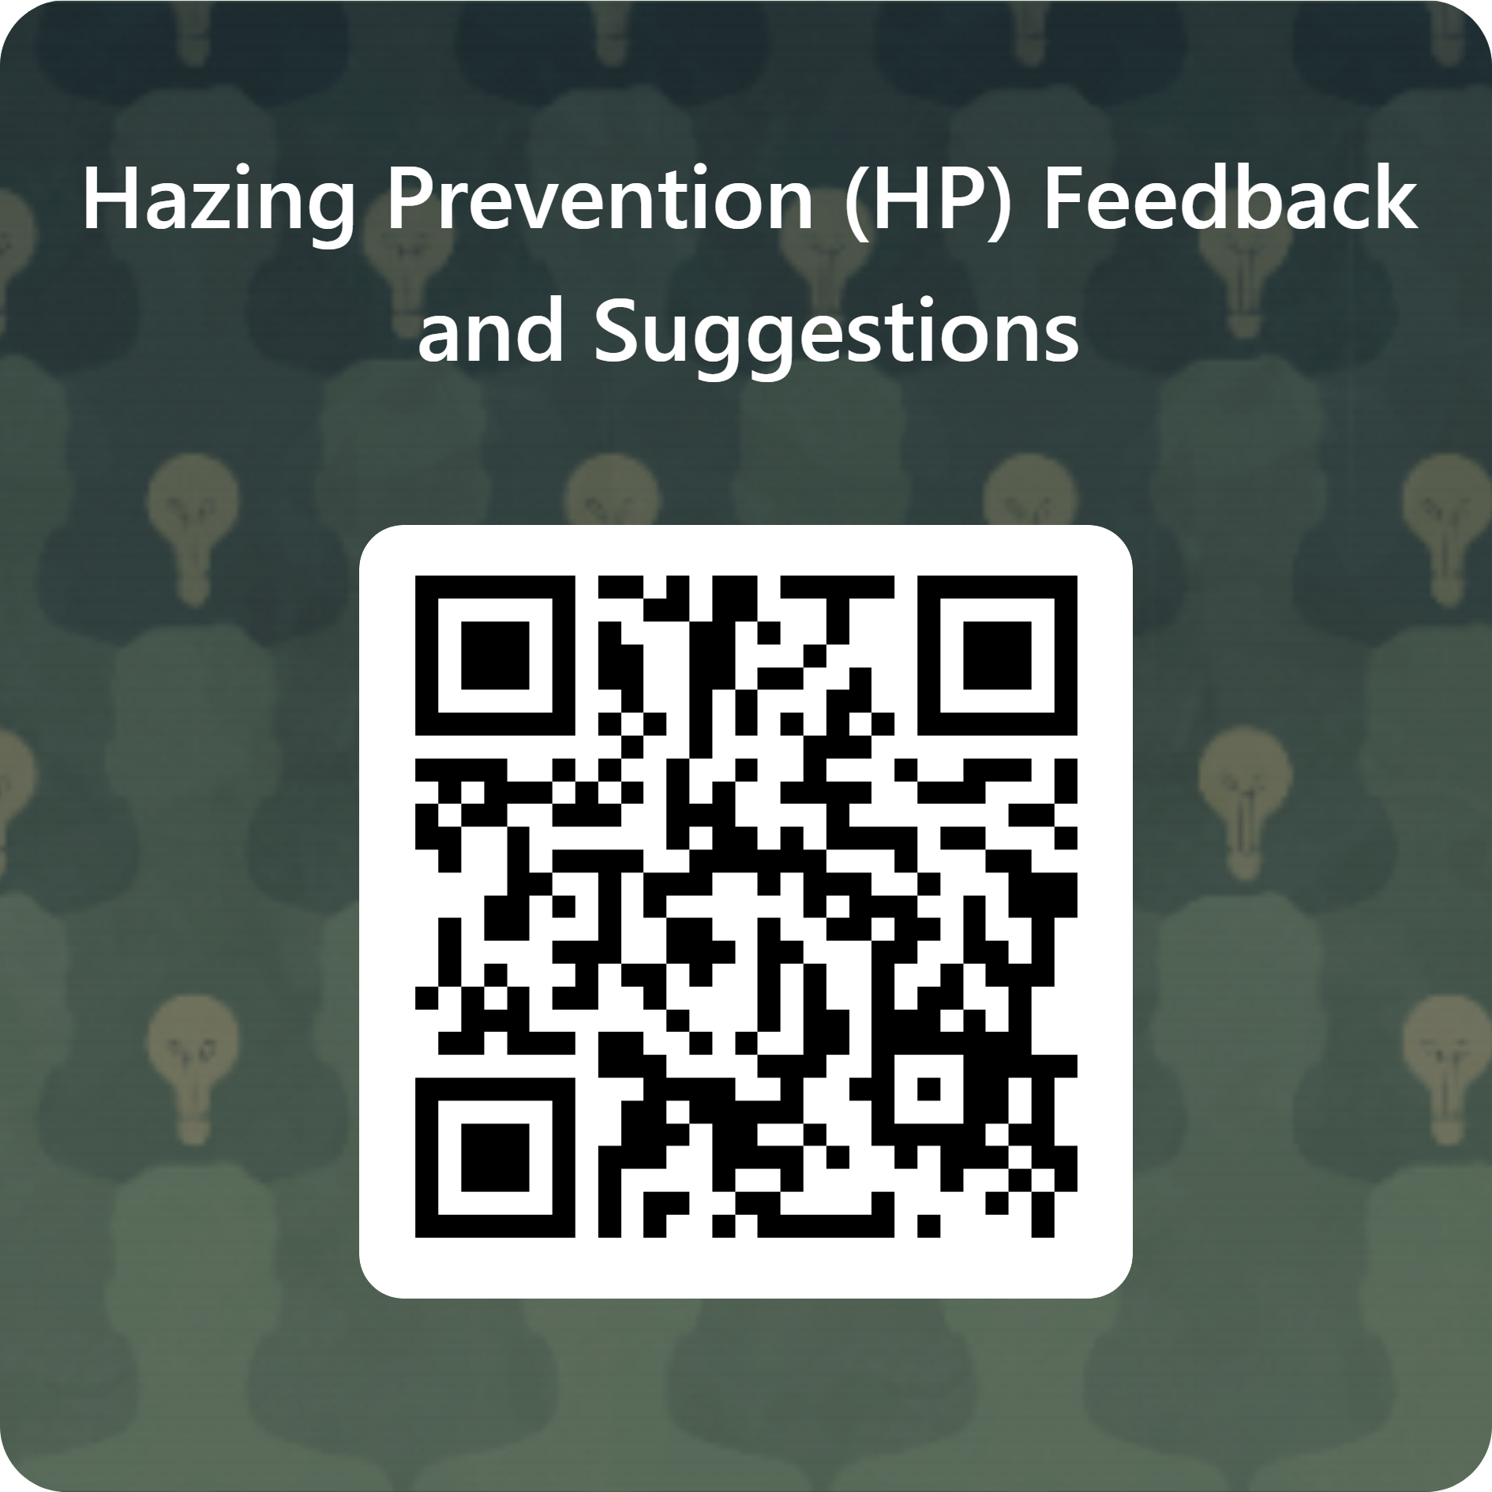
We Need Your Feedback & Suggestions
https://forms.office.com/r/zyXkRy0qnz

Slide 20
Vanetta Busch, PhD
Director, Hazing Prevention and Org. Development
Stophazing.nmsu.edu or
Studentlife.nmsu.edu
575-646-1722
drbusch@nmsu.edu

